Slide 1

Microsoft project
A commercial website based on Microsoft.com

Slide 2
Team members - Group 3
Đặng Hoàng Lan
Lê Lina
Cánh buồm phiêu du

Slide 3
Contents
Introduction
1
Development process
2
Difficulties
4
Achievements
3

Slide 4
INTRODUCTION
A brief look into our project

Slide 5
Introduction Lists of webpages
Microsoft Homepage www.microsoft.com/vi-vn/
Microsoft Store www.microsoft.com/vi-vn/store/b/home
Office 365 Home www.microsoft.com/vi-vn/store/d/office-365-home/cfq7ttc0k5dm/007R
Windows Hello www.microsoft.com/vi-vn/windows/windows-hello

Slide 6
Introduction More information
Inspirations: Create a website that can both sell products and give useful information about new technologies
Functions: Create front-end web only using HTML, CSS, Bootstrap (CSS frameworks) and Javascript
Goals: Better understanding in web development; Improve coding skills
Tools: Atom, Webstorm (Code editor), Balsamiq Mockup (Prototype tools), Github (Online Storage)

Slide 7
DEVELOPMENT PROCESS
Draw prototypes, layout, complete content

Slide 8


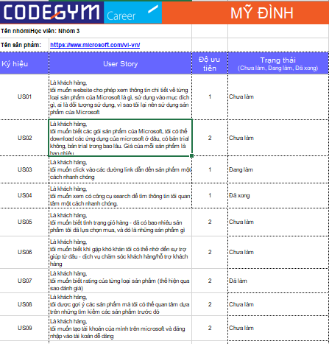



Development Process User Story/Product Backlog

Slide 9
Development Process Draw Prototypes
Microsoft Homepage
Windows Hello
Microsoft Store
Office 365 Home

Slide 10
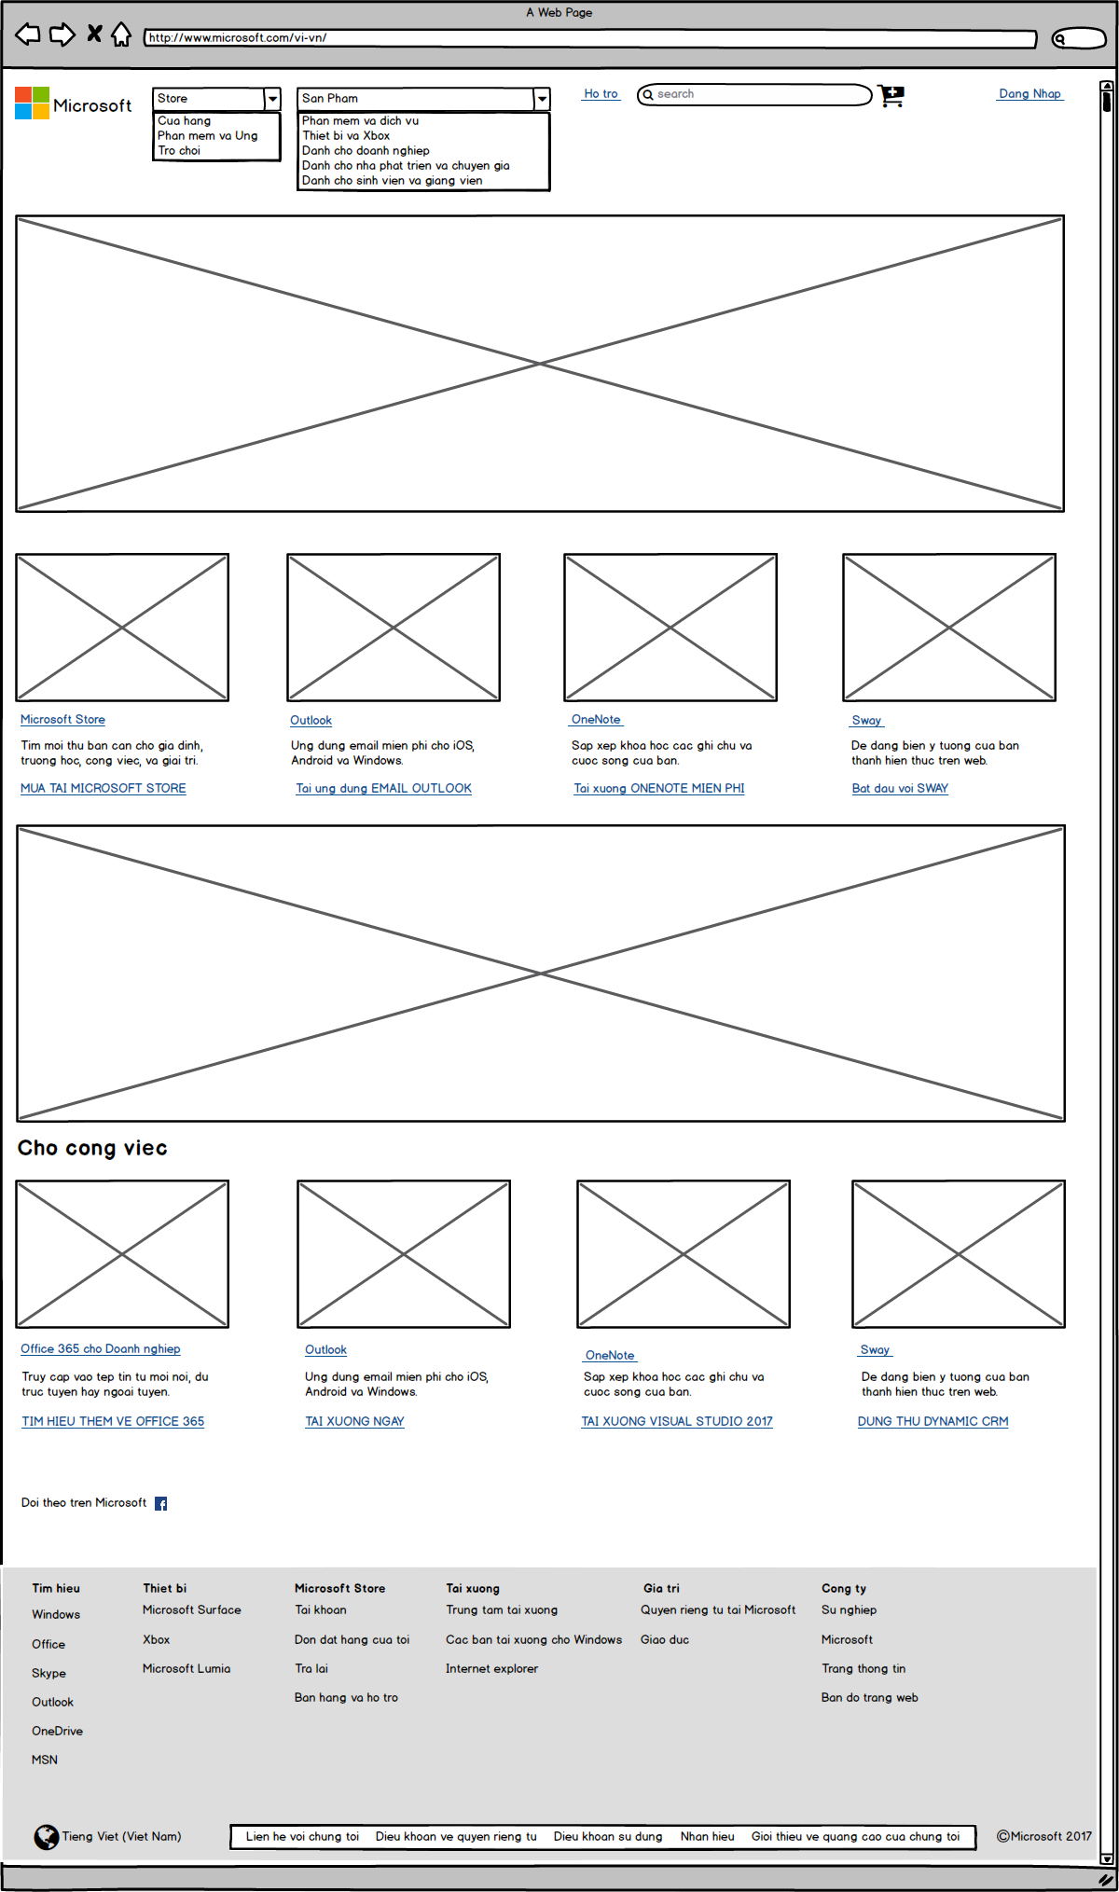
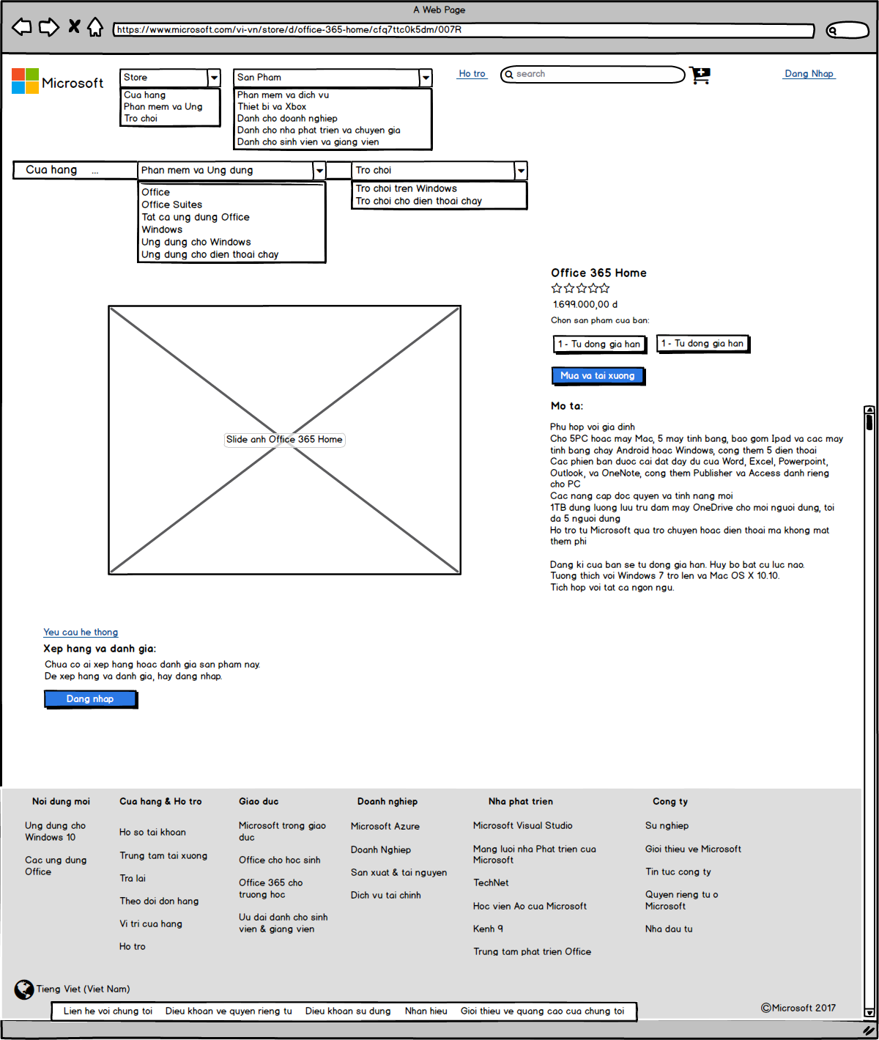
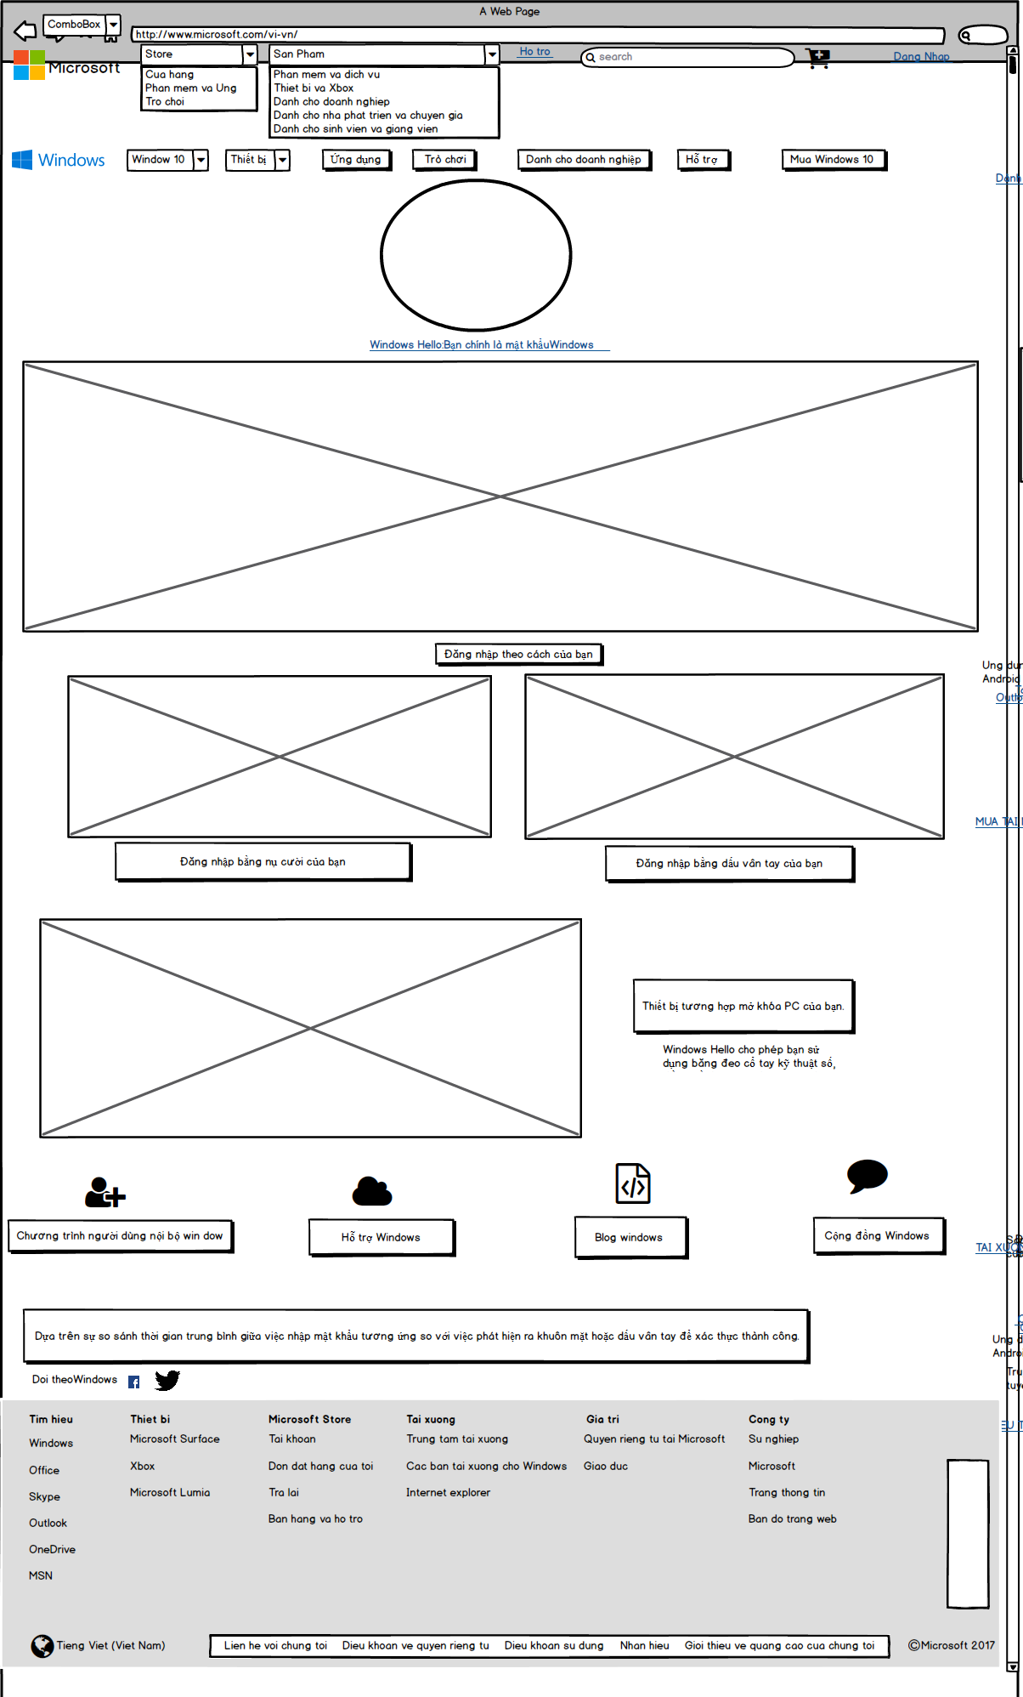
Microsoft Homepage
Office 365 Home
Windows Hello

Slide 11
ACHIEVEMENT
Our final product and the knowledge we acquired

Slide 12
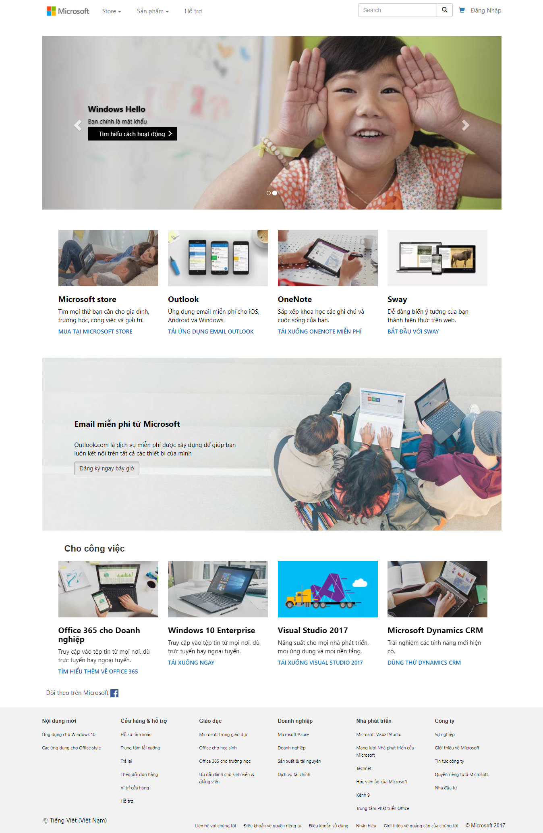
Achievement Our final product
Microsoft Homepage

Slide 13
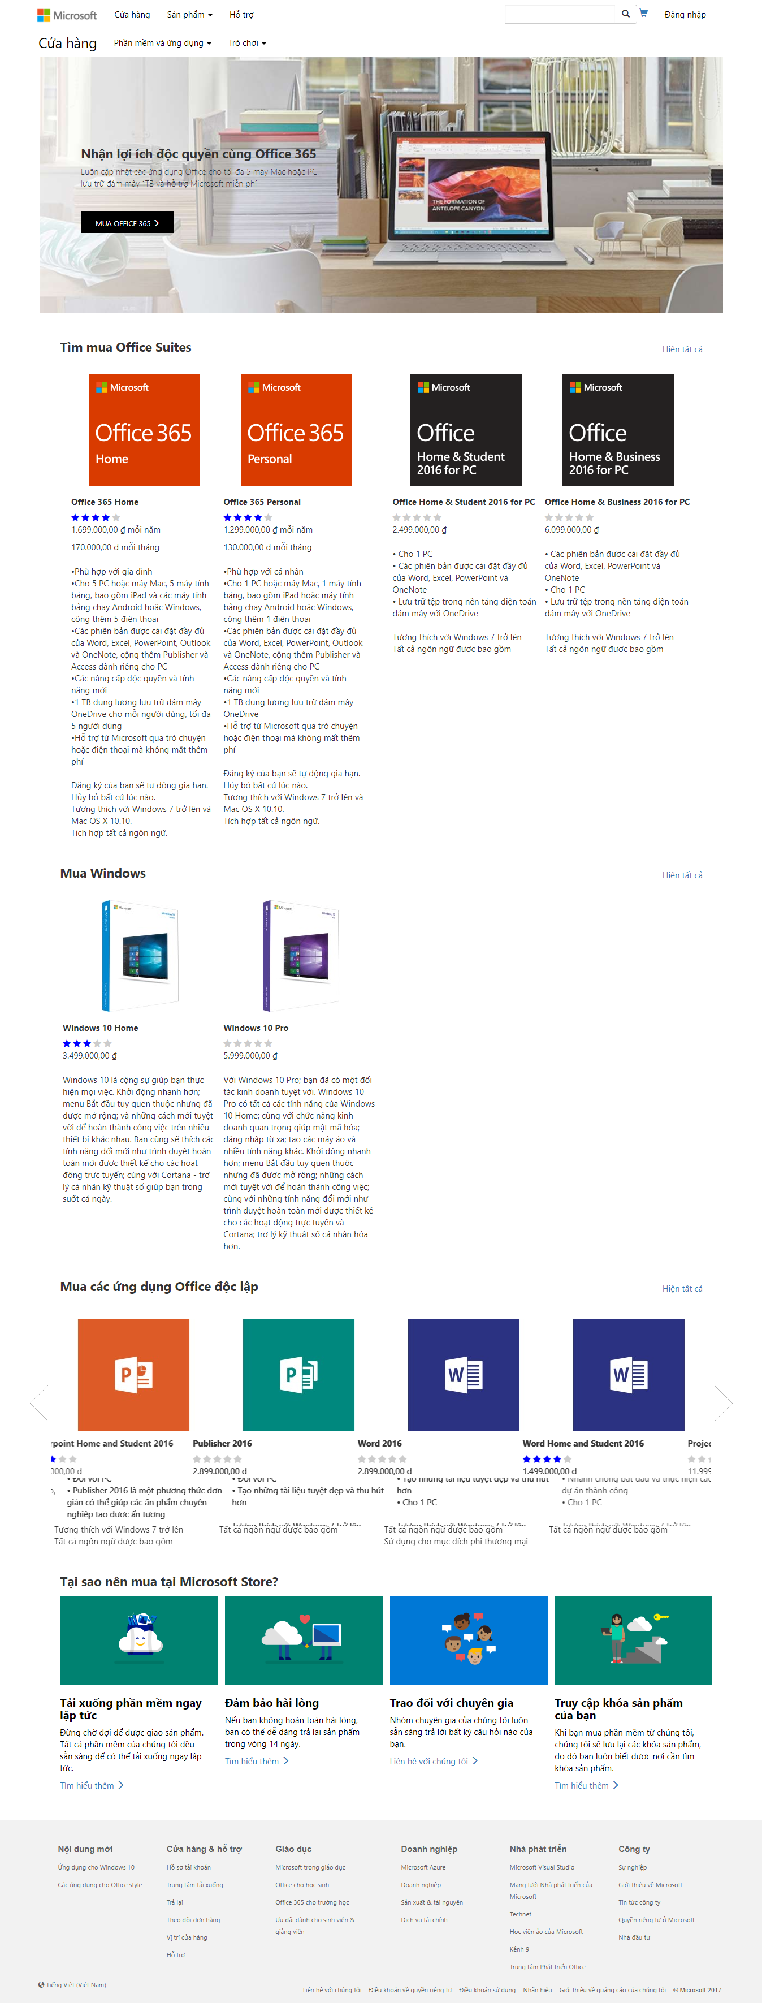
Achievement Our final product
Microsoft Store

Slide 14
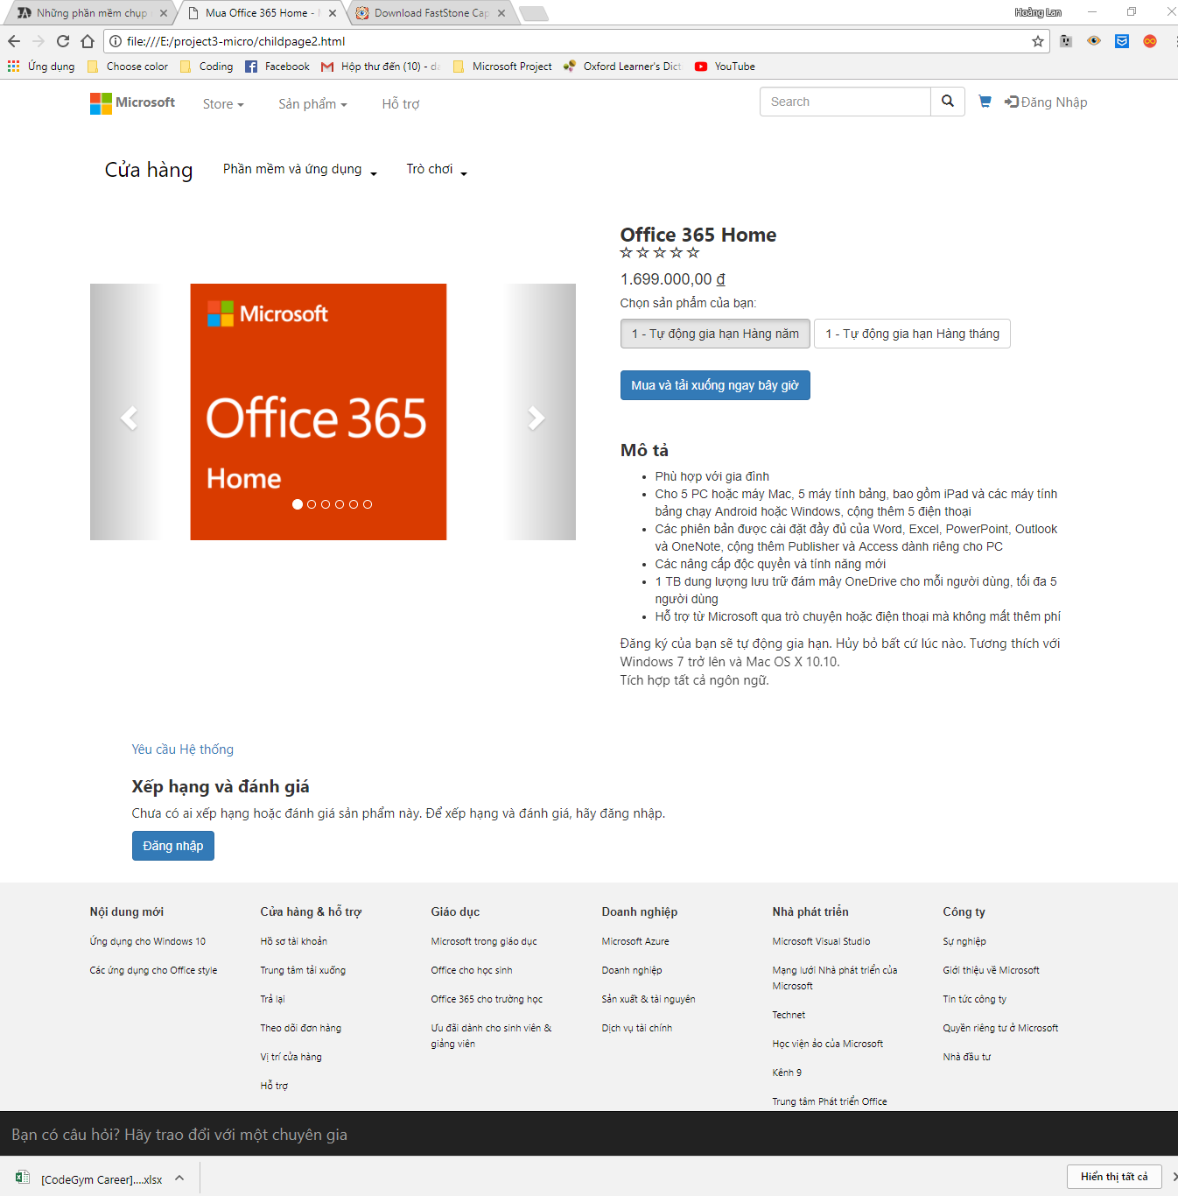
Achievement Our final product
Office 365 Home

Slide 15
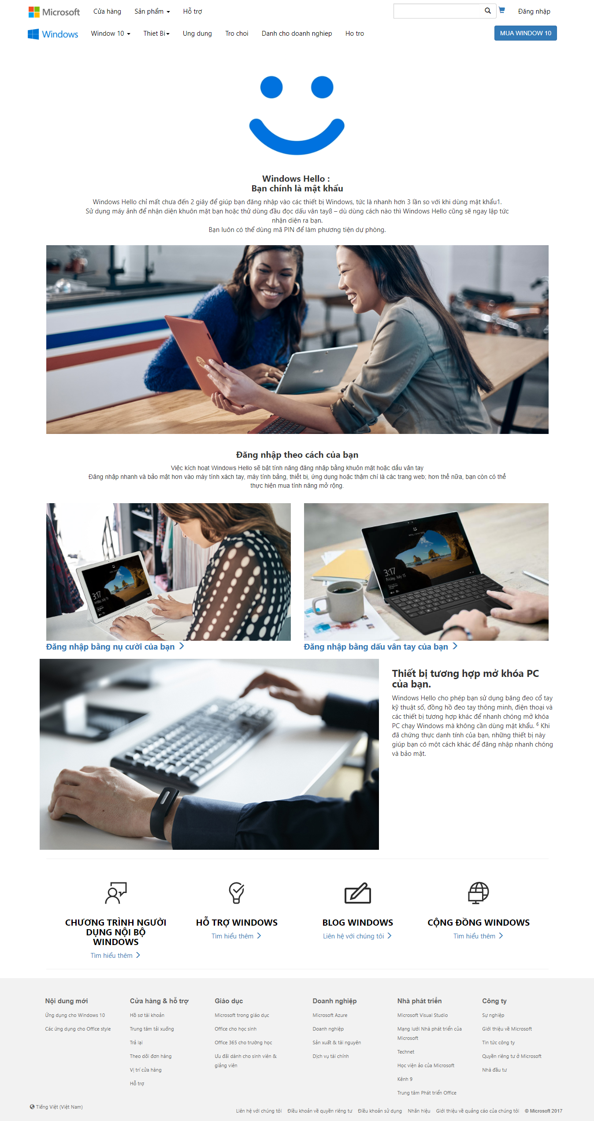
Achievement Our final product
Windows Hello

Slide 16

Achievement The knowledge & skills we acquire
Can build a static website (<5 webpages) with HTML, CSS
Create some dynamic effects into a webpages with Javascript (slideshows, toggle)
Can use one of the most popular CSS framworks – Bootstrap.
Can use the online storage Github and collaborate with other team members
Improve teamwork skills

Slide 17
Difficulties
The obstacles we met during project implementation

Slide 18

Difficulties
Limited Javascript knowledge + Dependent on Bootstrap Jquery library → cannot fully customize the dynamic effect of the webpages
Limited time for coding due to work and study
Ineffective collaboration within team members
Website is static (not communicate with the server-side) → limited features

Slide 19
THANK YOU FOR LISTENING!

